Slide 1
Medical Image Classification Using Deep Learning
[Myna Cheekati(U00864169)]
[Mohan Sai Goli(U00906040)]

Slide 2
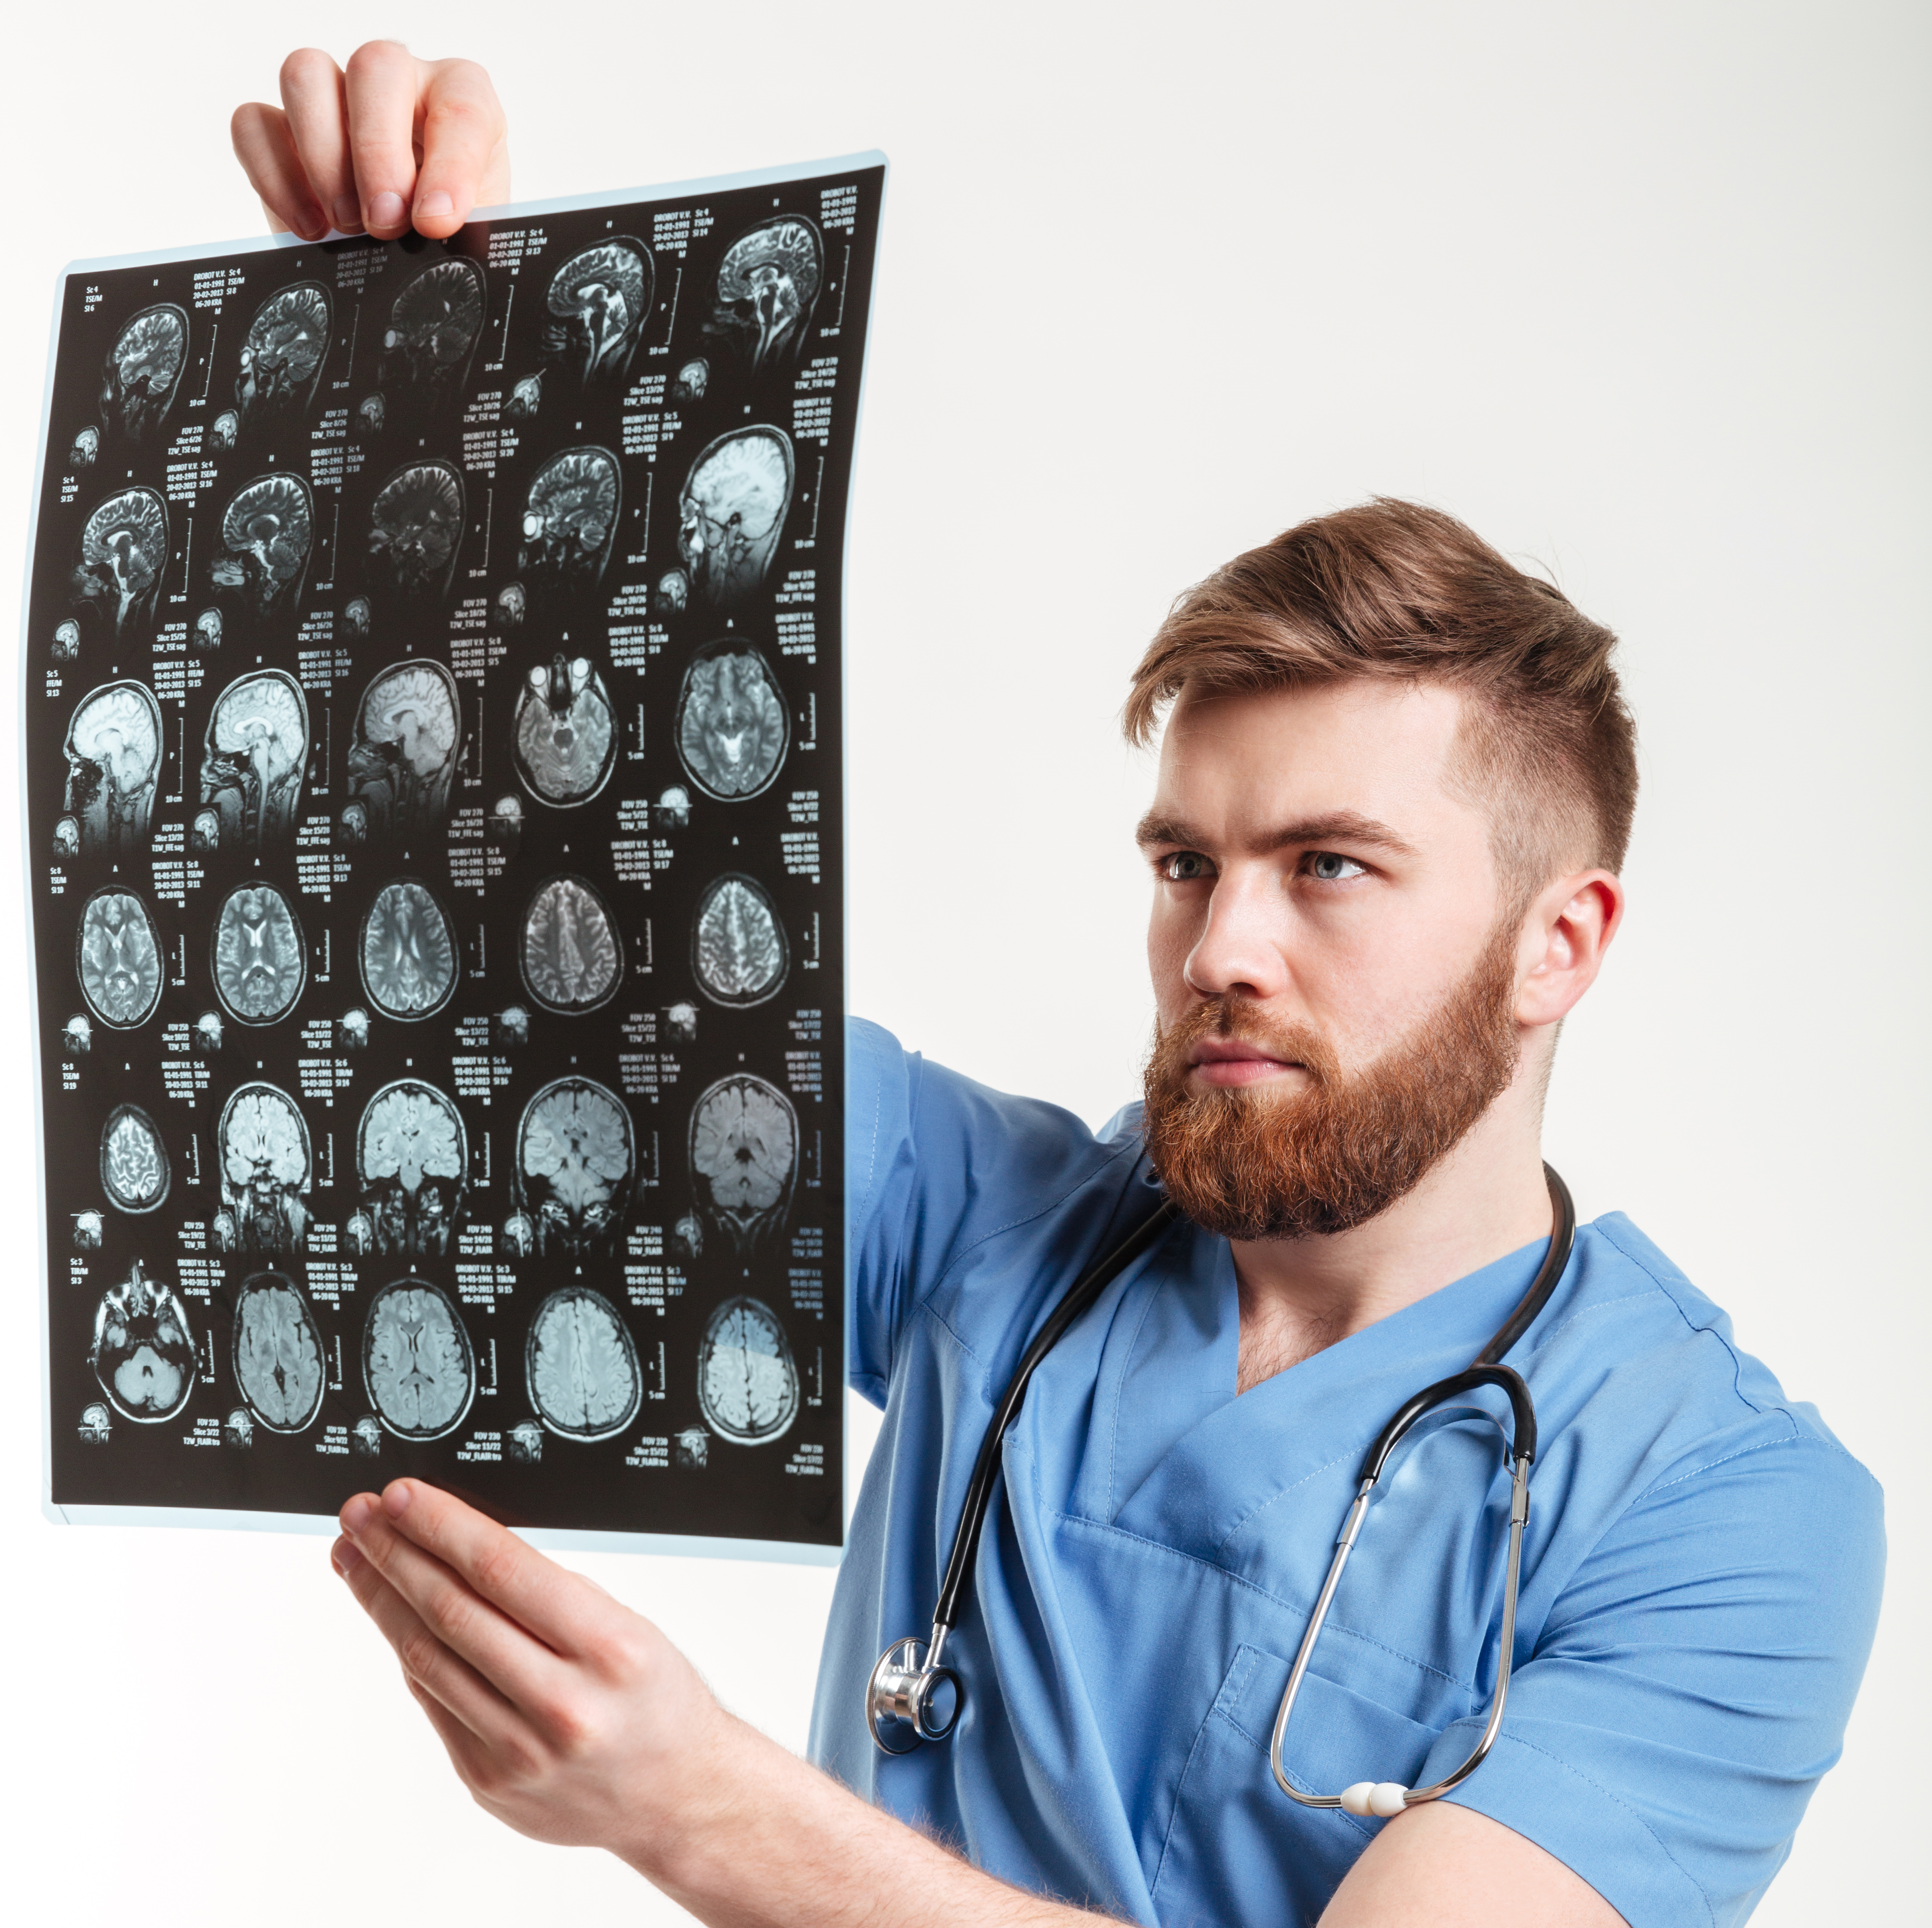
Problem Statement
Alzheimer’s Disease Detection
Using MRI scans to detect Alzheimer’s disease early and accurately.
Traditional methods have a high probability for errors
The Figure shows Traditional image analysis

Slide 3
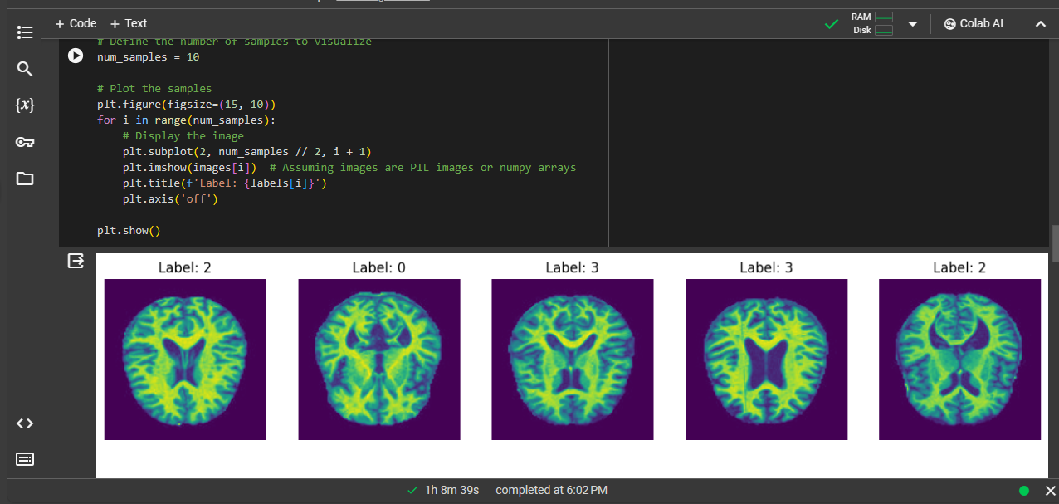
Solution Overview
Deep Learning Model for Image Classification
We built a model that classifies MRI scans to detect Alzheimer’s disease.
The figure shows sampleimages and labels from Alzheimer Disease.

Slide 4
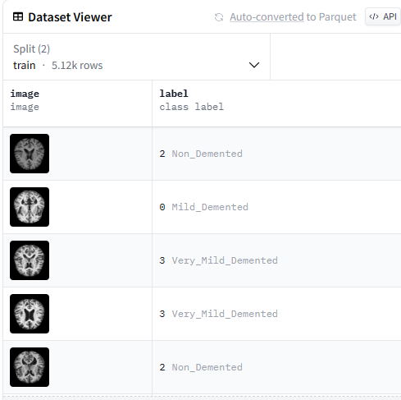
Dataset
Dataset Name: Falah/Alzheimer_MRI
Task: Image Classification
Dataset Splits:
Train split: 5,120 examples
Test split: 1,280 examples
Total Download Size: 28,289,848 bytes
Total Dataset Size: 28,198,238.28 bytes
Labels:
‘0’: Mild_Demented
‘1’: Moderate_Demented
‘2’: Non_Demented
‘3’: Very_Mild_Demented

Slide 5
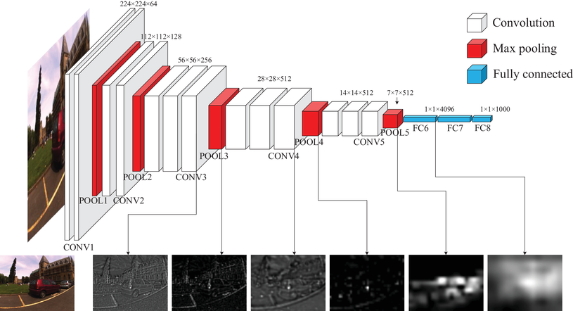
Model Architecture
Pre-trained VGG16 Model
Input Shape: 224 x 224 x 3
Weights: ‘imagenet’
Layers: Frozen
Additional Layers
Flatten Layer
Dense Layer: 512 neurons, Activation: ‘relu’
Dropout Layer: 0.5 dropout rate
Dense Layer: 1 neuron, Activation: ‘sigmoid’

Slide 6
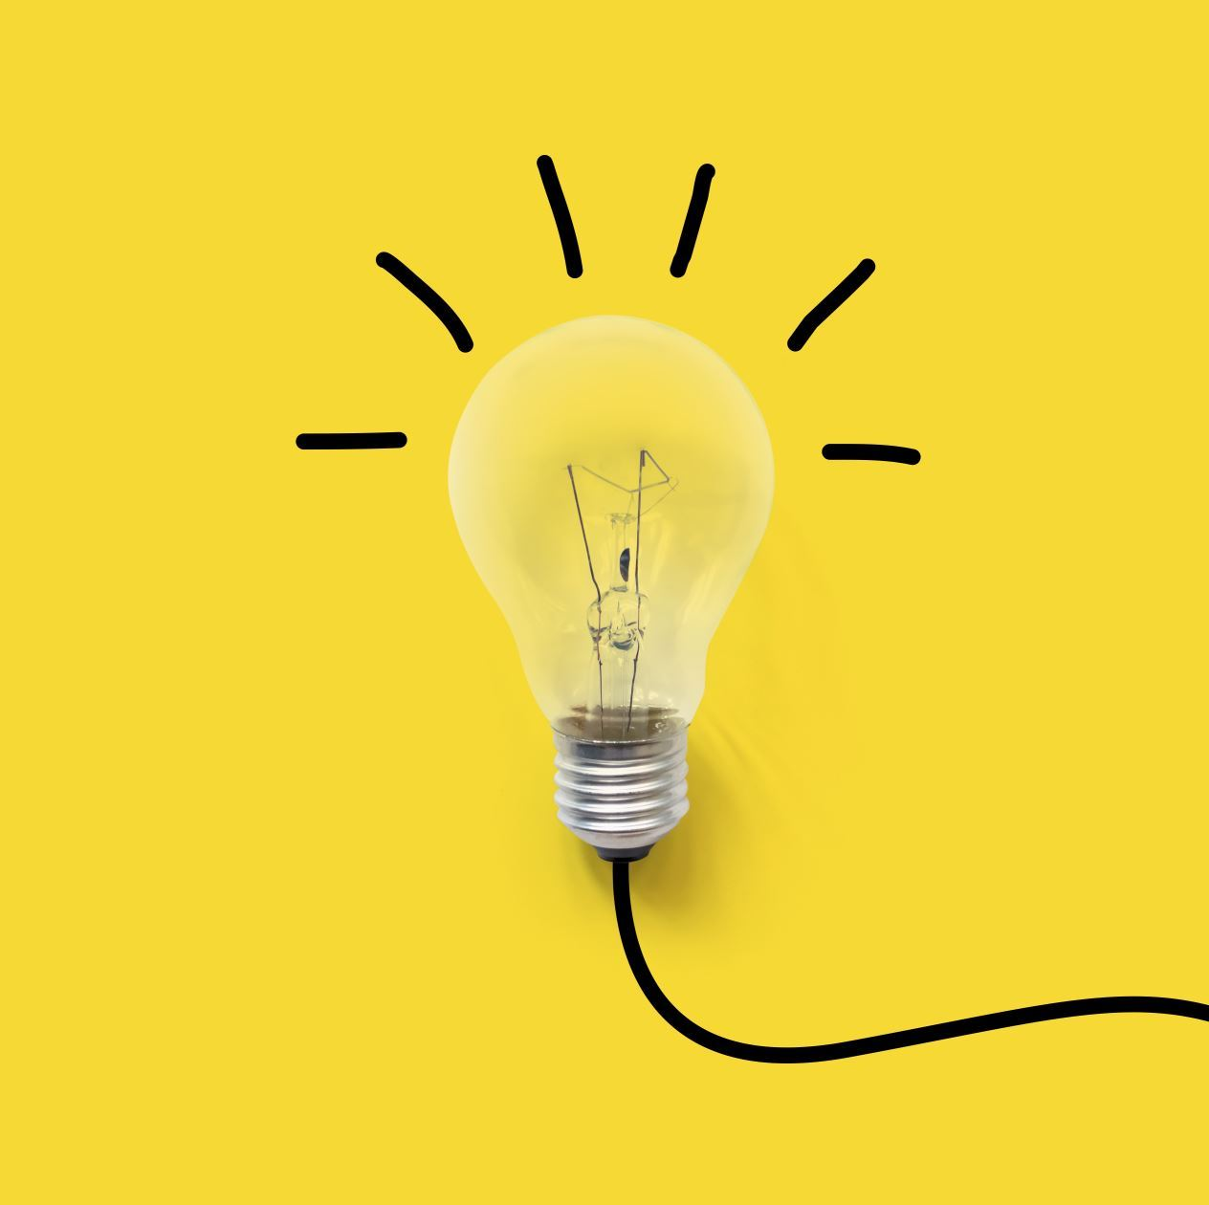
Model Enhancement
Improving Model Accuracy
Data Augmentation
Increased Neurons in Dense Layer
During training, data augmentation is applied using ImageDataGenerator to create variations of the training images, helping the model generalize better.
The model is trained using the fit() function with the augmented training data (datagen.flow(x_train, y_train)) for a specified number of epochs.
Callbacks such as ModelCheckpoint, EarlyStopping, and ReduceLROnPlateau are used to save the best model, prevent overfitting, and adjust the learning rate dynamically based on the validation loss.

Slide 7
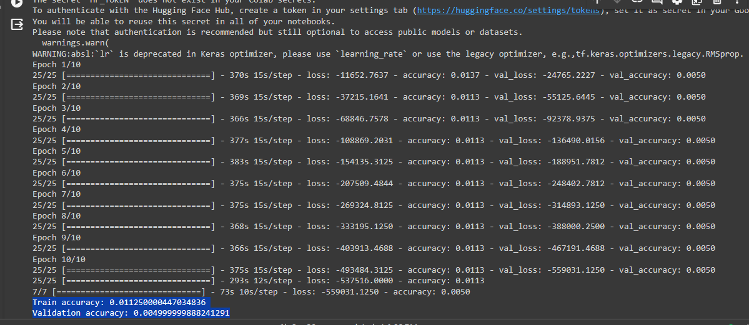
Results
Model Performance
Train accuracy: 0.0112
Validation accuracy: 0.0049
The training was successful but low accuracy suggests further improvements have to be done

Slide 8
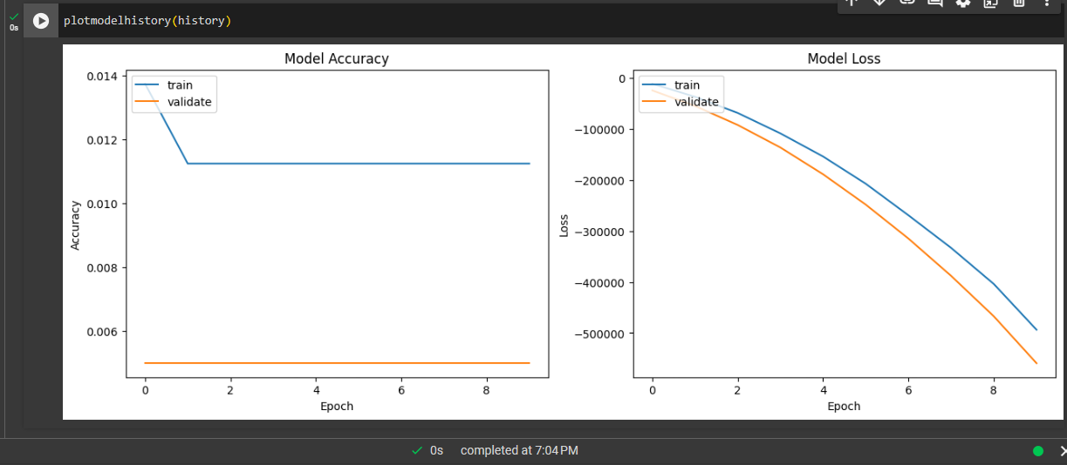
visualizing the accuracy and loss over epochs

Slide 9

Conclusion
The project focused on building a convolutional neural network (CNN) for medical image analysis using the Falah/Alzheimer_MRI dataset. The dataset contained images along with labels indicating the presence or absence of Alzheimer's disease. The model architecture leveraged transfer learning with the VGG16 pre-trained model as a convolutional base.

Slide 10
Future Work
Fine-tuning Hyperparameters: Experiment with different hyperparameters such as learning rate, dropout rate, batch size, and the number of trainable layers in the base model to further optimize the model's performance.
Explore Other Pre-trained Models: Besides VGG16, explore other pre-trained models such as ResNet, Inception, or EfficientNet to see if they offer better performance for the given dataset.
Data Augmentation: Experiment with additional data augmentation techniques or adjust the parameters of existing ones to further improve model generalization and robustness.
Ensemble Methods: Explore ensemble learning techniques by combining predictions from multiple models trained on different subsets of the data or using different architectures.
Model Interpretability: Investigate methods for interpreting model predictions and understanding which features contribute most to the classification decisions, especially in the medical domain where interpretability is crucial.

Slide 11
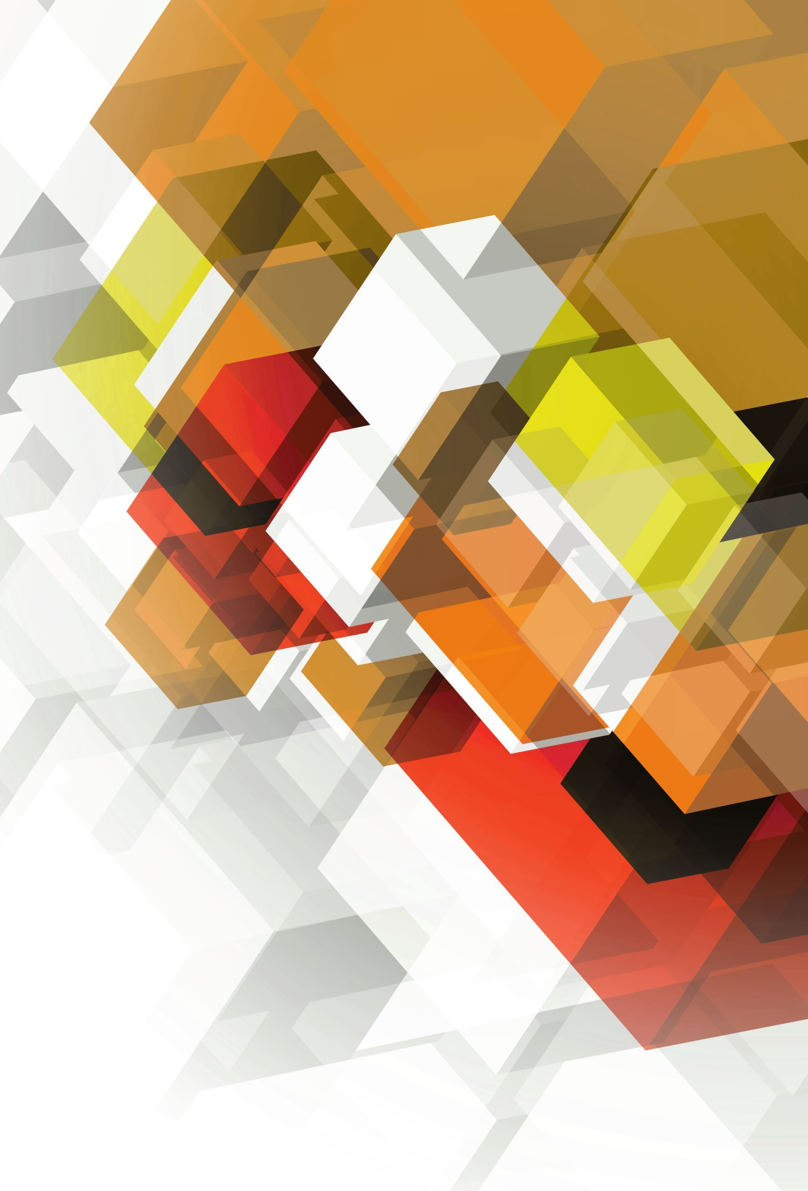
Thank You
End

